Slide 1
Local Search Engine
Team Members :-
Tushar Deshwal
Anirudh Singh Palawat
Vishnu Yadav
Sourav

Slide 2

AGENDA
Introduction of LSE
Functionalities
Flowcharts
Output

Slide 3
INTRODUCTION
A search engine is a program which will search for the input given by the user, the database in which it searches could be a remote server or the local machine.
A local search engine is just like the search feature in file explorer.
The term local here means that it will only search among the files present on the machine that it is being executed on i.e. the database here is the files present on the local machine.

Slide 4

functionalities
It provide an appropriate menu driven user interface.
Search through the file system.
It search for a given word/string and list all the files.
It search for a particular file ,when path is given.
It display the contents of the file from the listing files.
It display appropriate error messages when searching fails.

Slide 5
User defined header file
header.h
1
All the predefined header files are included in it.
Example - iostream, string, dirent.h etc.
2
All the macros used are defined in it.
Some of them are - MAX_LENGTH, MAX_FILENAME, LINE etc.
3

Slide 6
User defined header file
localSearchEngine.h
1
Contains declaration of all the functions and variables.
Example - searchInFilename() , searchByWord() etc.
2
Contains structure for linked list used for storing file name and path name.
3

Slide 7
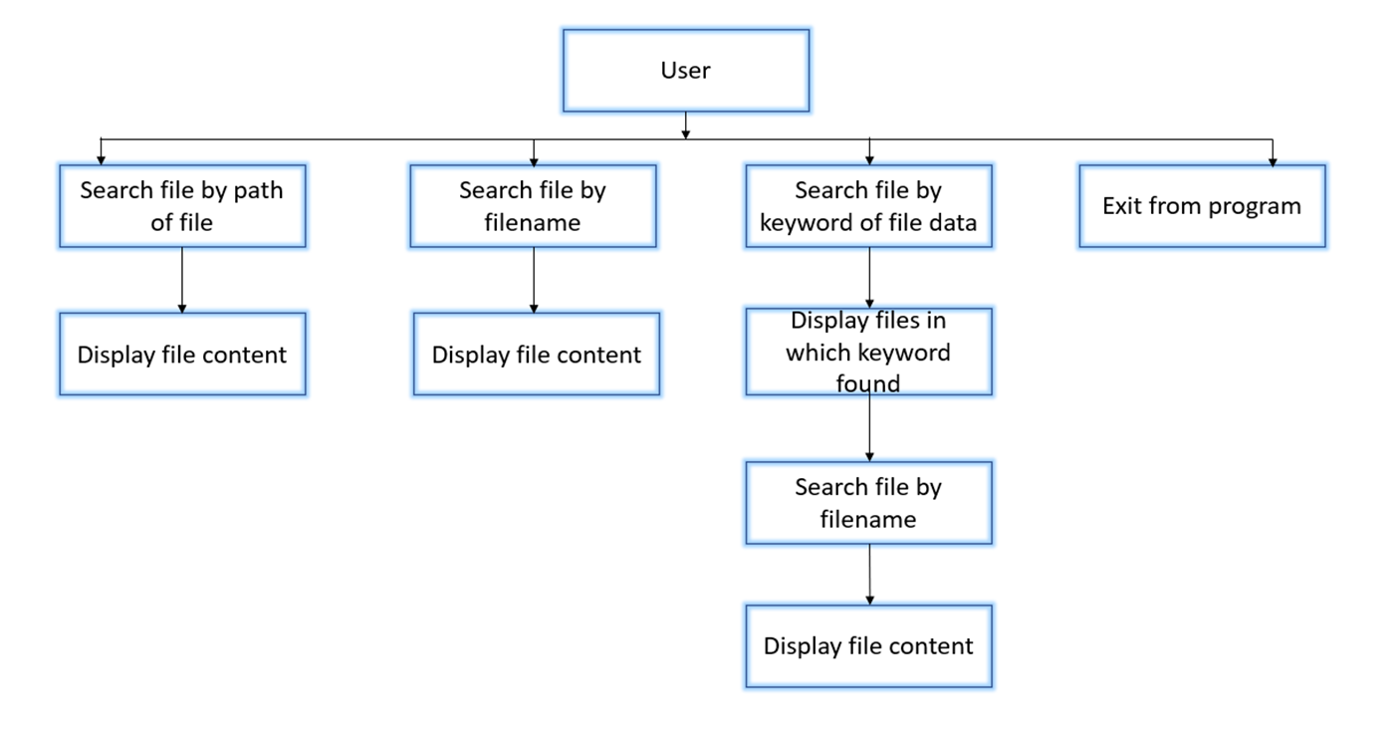
System Architecture Diagram

Slide 8
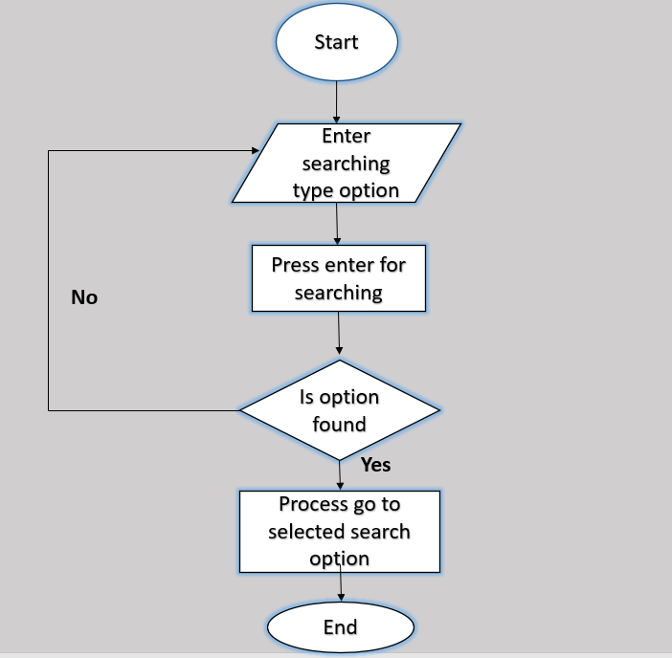
Menu

Slide 9
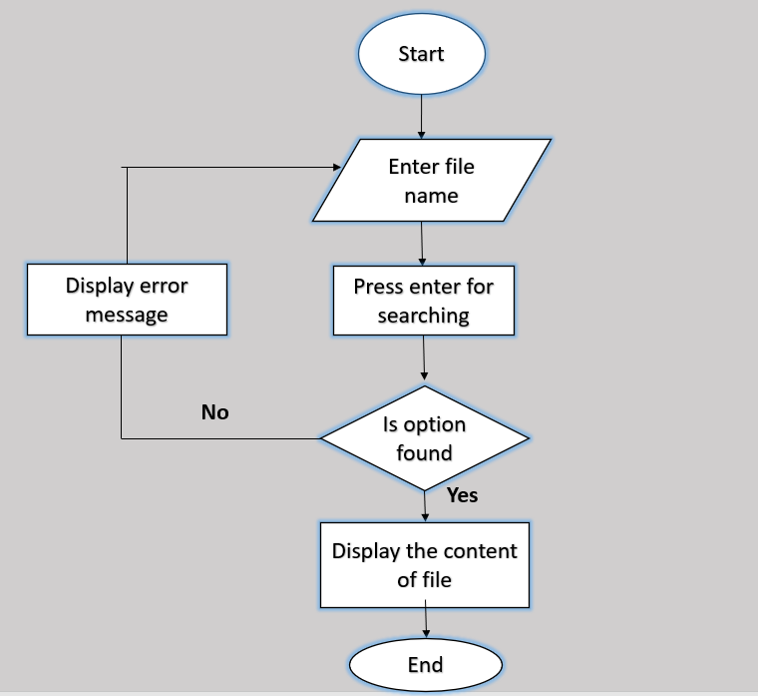
FUNCTIONALITIES FLOWCHARTS
SEARCH FILES

Slide 10
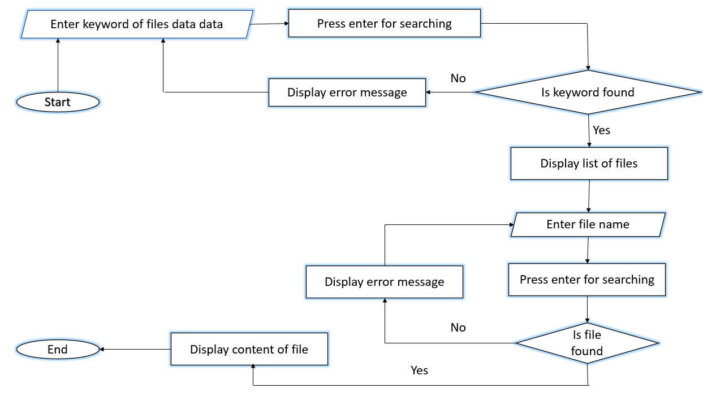
Search keyword in files

Slide 11
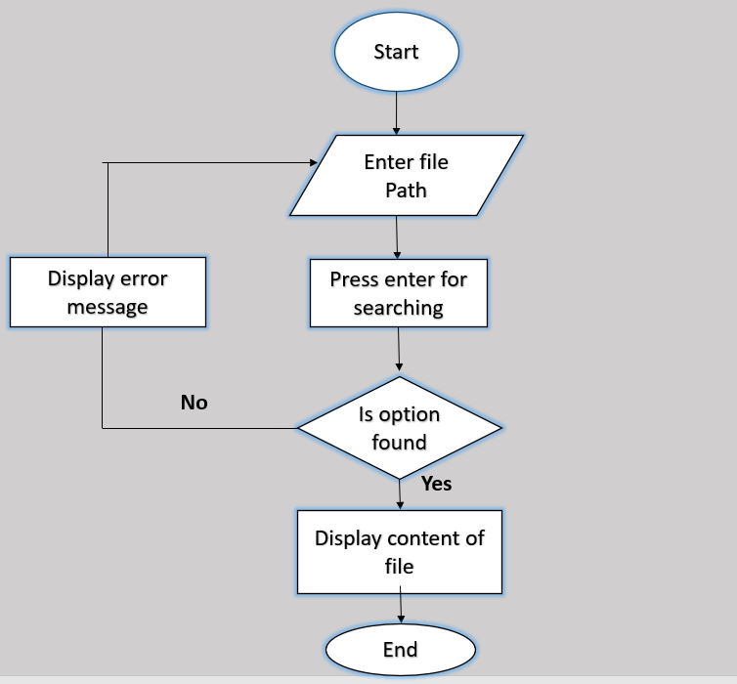
Search files by path

Slide 12
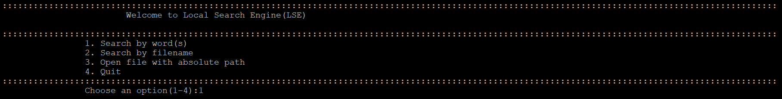
Menu

Slide 13
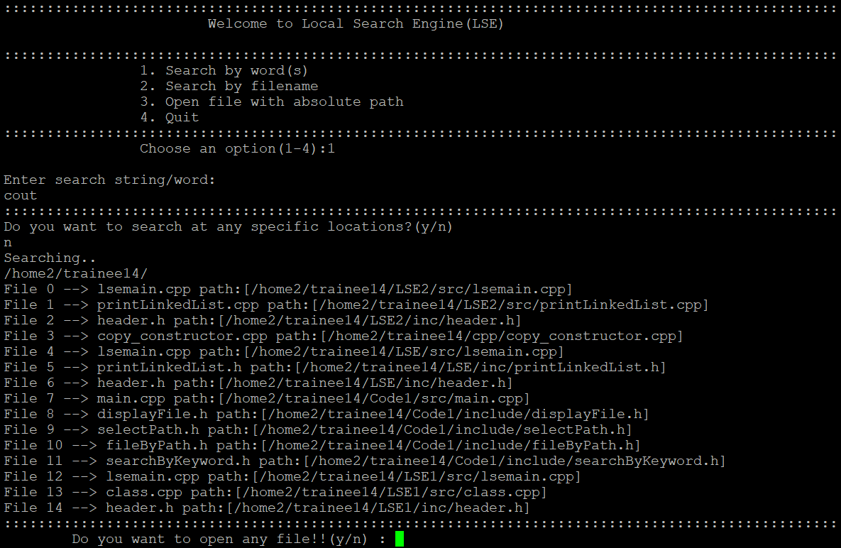
Search By word

Slide 14
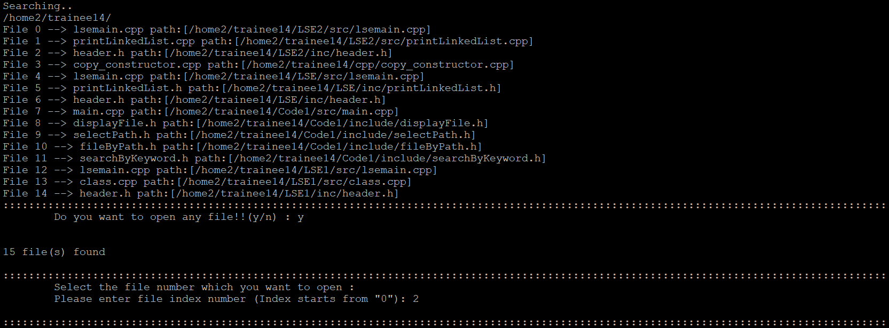
Display The content

Slide 15
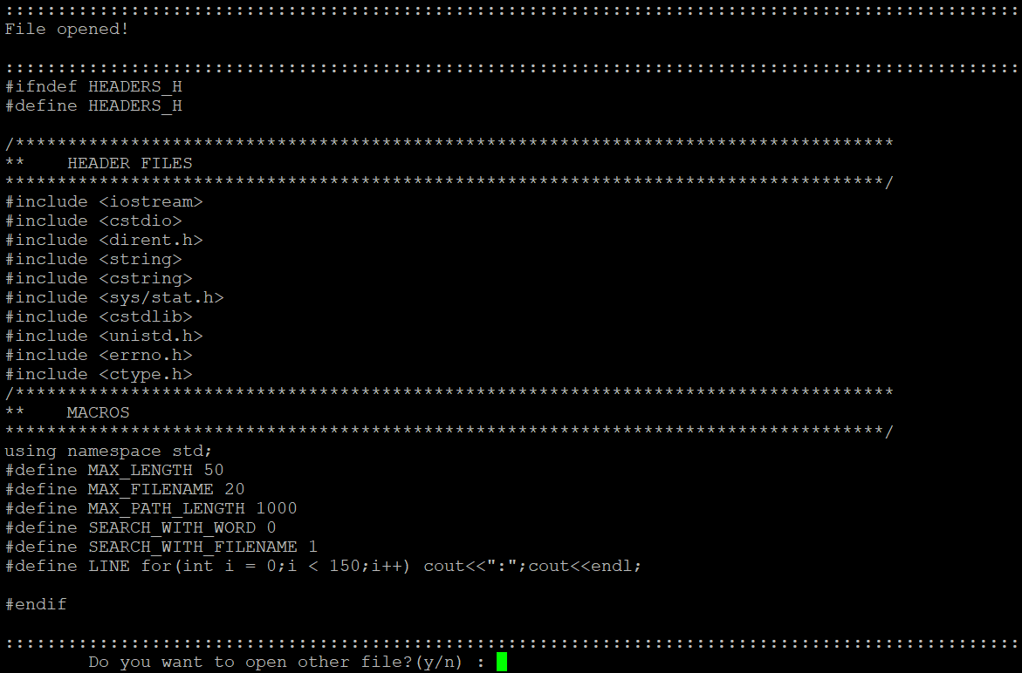

Slide 16
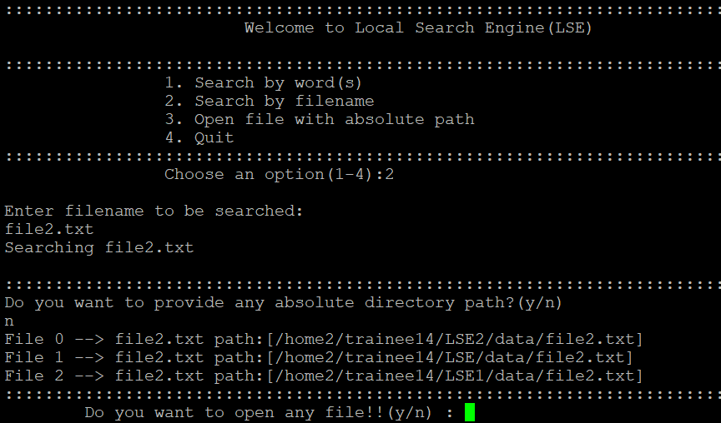
Search by file name

Slide 17
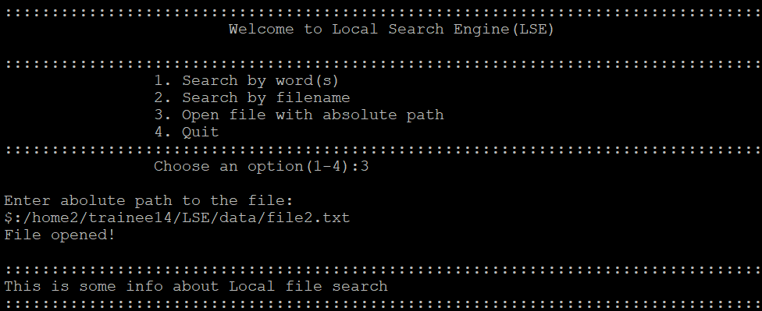
Search by path

Slide 18

GET THE FUTURE YOU WANT
capgemini.com

Slide 19
About Capgemini
Capgemini is a global leader in partnering with companies to transform and manage their business by harnessing the power of technology. The Group is guided everyday by its purpose of unleashing human energy through technology for an inclusive and sustainable future. It is a responsible and diverse organization of over 360,000 team members more than 50 countries. With its strong 55-year heritage and deep industry expertise, Capgemini is trusted by its clients to address the entire breadth of their business needs, from strategy and design to operations, fueled by the fast evolving and innovative world of cloud, data, AI, connectivity, software, digital engineering and platforms. The Group reported in 2022 global revenues of €22 billion.
Get The Future You Want | www.capgemini.com

